Slide 1
CSC 3210 Computer Organization and Programming
Lab Work 7
Dr. Zulkar Nine
mnine@gsu.edu
Georgia State University
Summer 2021

Slide 2
Learning Objective
Data Transfer,
Arithmetic instructions with variables

Slide 3
Disclaimer
The process shown in these slides might not work in every single computer due to Operating system version, Microsoft Visual Studio versions and everything.
If you find any unusual error, you can inform the instructor.
Instructor will help you resolve the issue.

Slide 4
Attendance!

Slide 5
Lab Work 7 Instructions
Lab 7(a): Expression evaluation
Due Date: posted on icollege

Slide 6
Plan early …
You have one week time to submit the lab
Start early
If you have issues
Email TA or instructor
Stop by during office hours
Start working at the last moment is not a good idea.
Appendix shows how to create a new project.

Slide 7
Implementing Arithmetic Expressions
HLL compilers translate mathematical expressions into assembly language.
You can do it also.
For example: Do not permit Xval, Yval, or Zval to be modified
Rval = -Xval + (Yval – Zval)
.code
mov eax,Xval
neg eax ; EAX = -26
mov ebx,Yval
sub ebx,Zval ; EBX = -10
add eax,ebx
mov Rval,eax ; -36
.data
Rval SDWORD ?
Xval SDWORD 26
Yval SDWORD 30
Zval SDWORD 40

Slide 8
Implementing Arithmetic Expressions
Translate the following expression into assembly language.
Do not permit Xval, Yval, or Zval to be modified:
Rval = Xval - (-Yval + Zval)
Previous Example:
Rval = -Xval + (Yval – Zval)
Assume that all values are signed doublewords.
mov ebx,Yval
neg ebx
add ebx,Zval
mov eax,Xval
sub eax,ebx
mov Rval,eax
.data
Rval SDWORD ?
Xval SDWORD 26
Yval SDWORD 30
Zval SDWORD 40

Slide 9
Lab 7(a) Expression evaluation
Submission

Slide 10
Submission Instruction
Create a new application to run the following program.
The data segment is provided:
.data
Val1 SWORD 23
Val2 SWORD -35
Val3 SDWORD 4
Evaluate the following expression :
EBX = (-Val1 + val2) + (val3*3)
You can only use Mov, Movsz, Movzx, Add, Sub instructions.
Build and run the program using the debugger
Examine the content of the registers

Slide 11
Appendix
Create a Project

Slide 12
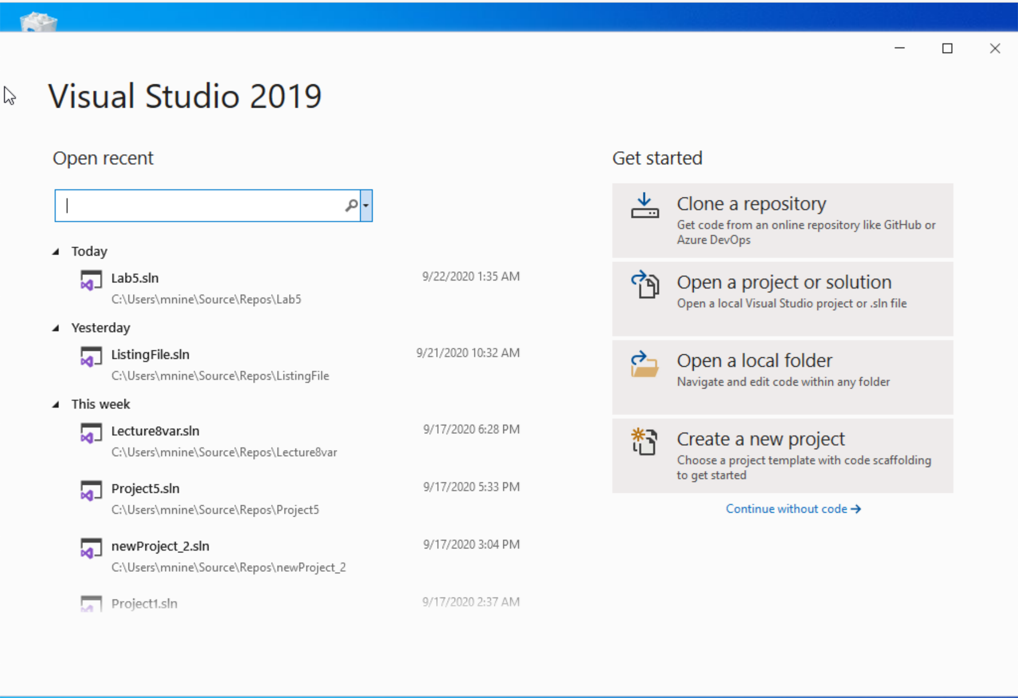


Step 1: Create a project (1)
Start Visual Studio
Click Create a new Project

Slide 13
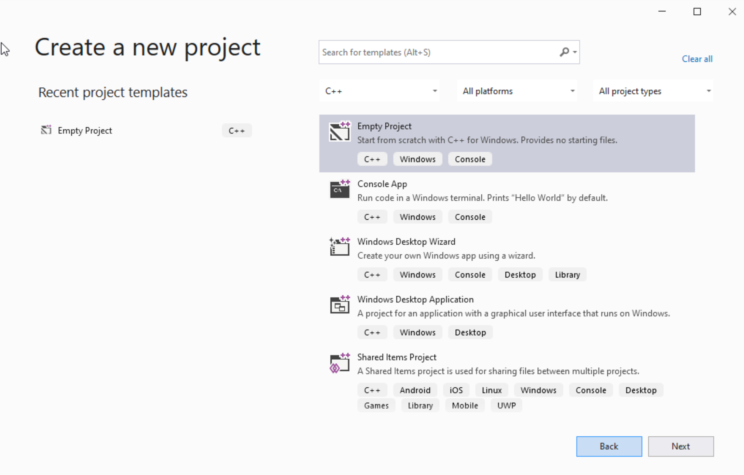




Step 1: Create a project (2)
Select C++ as language
Select Empty Project
Click Next

Slide 14
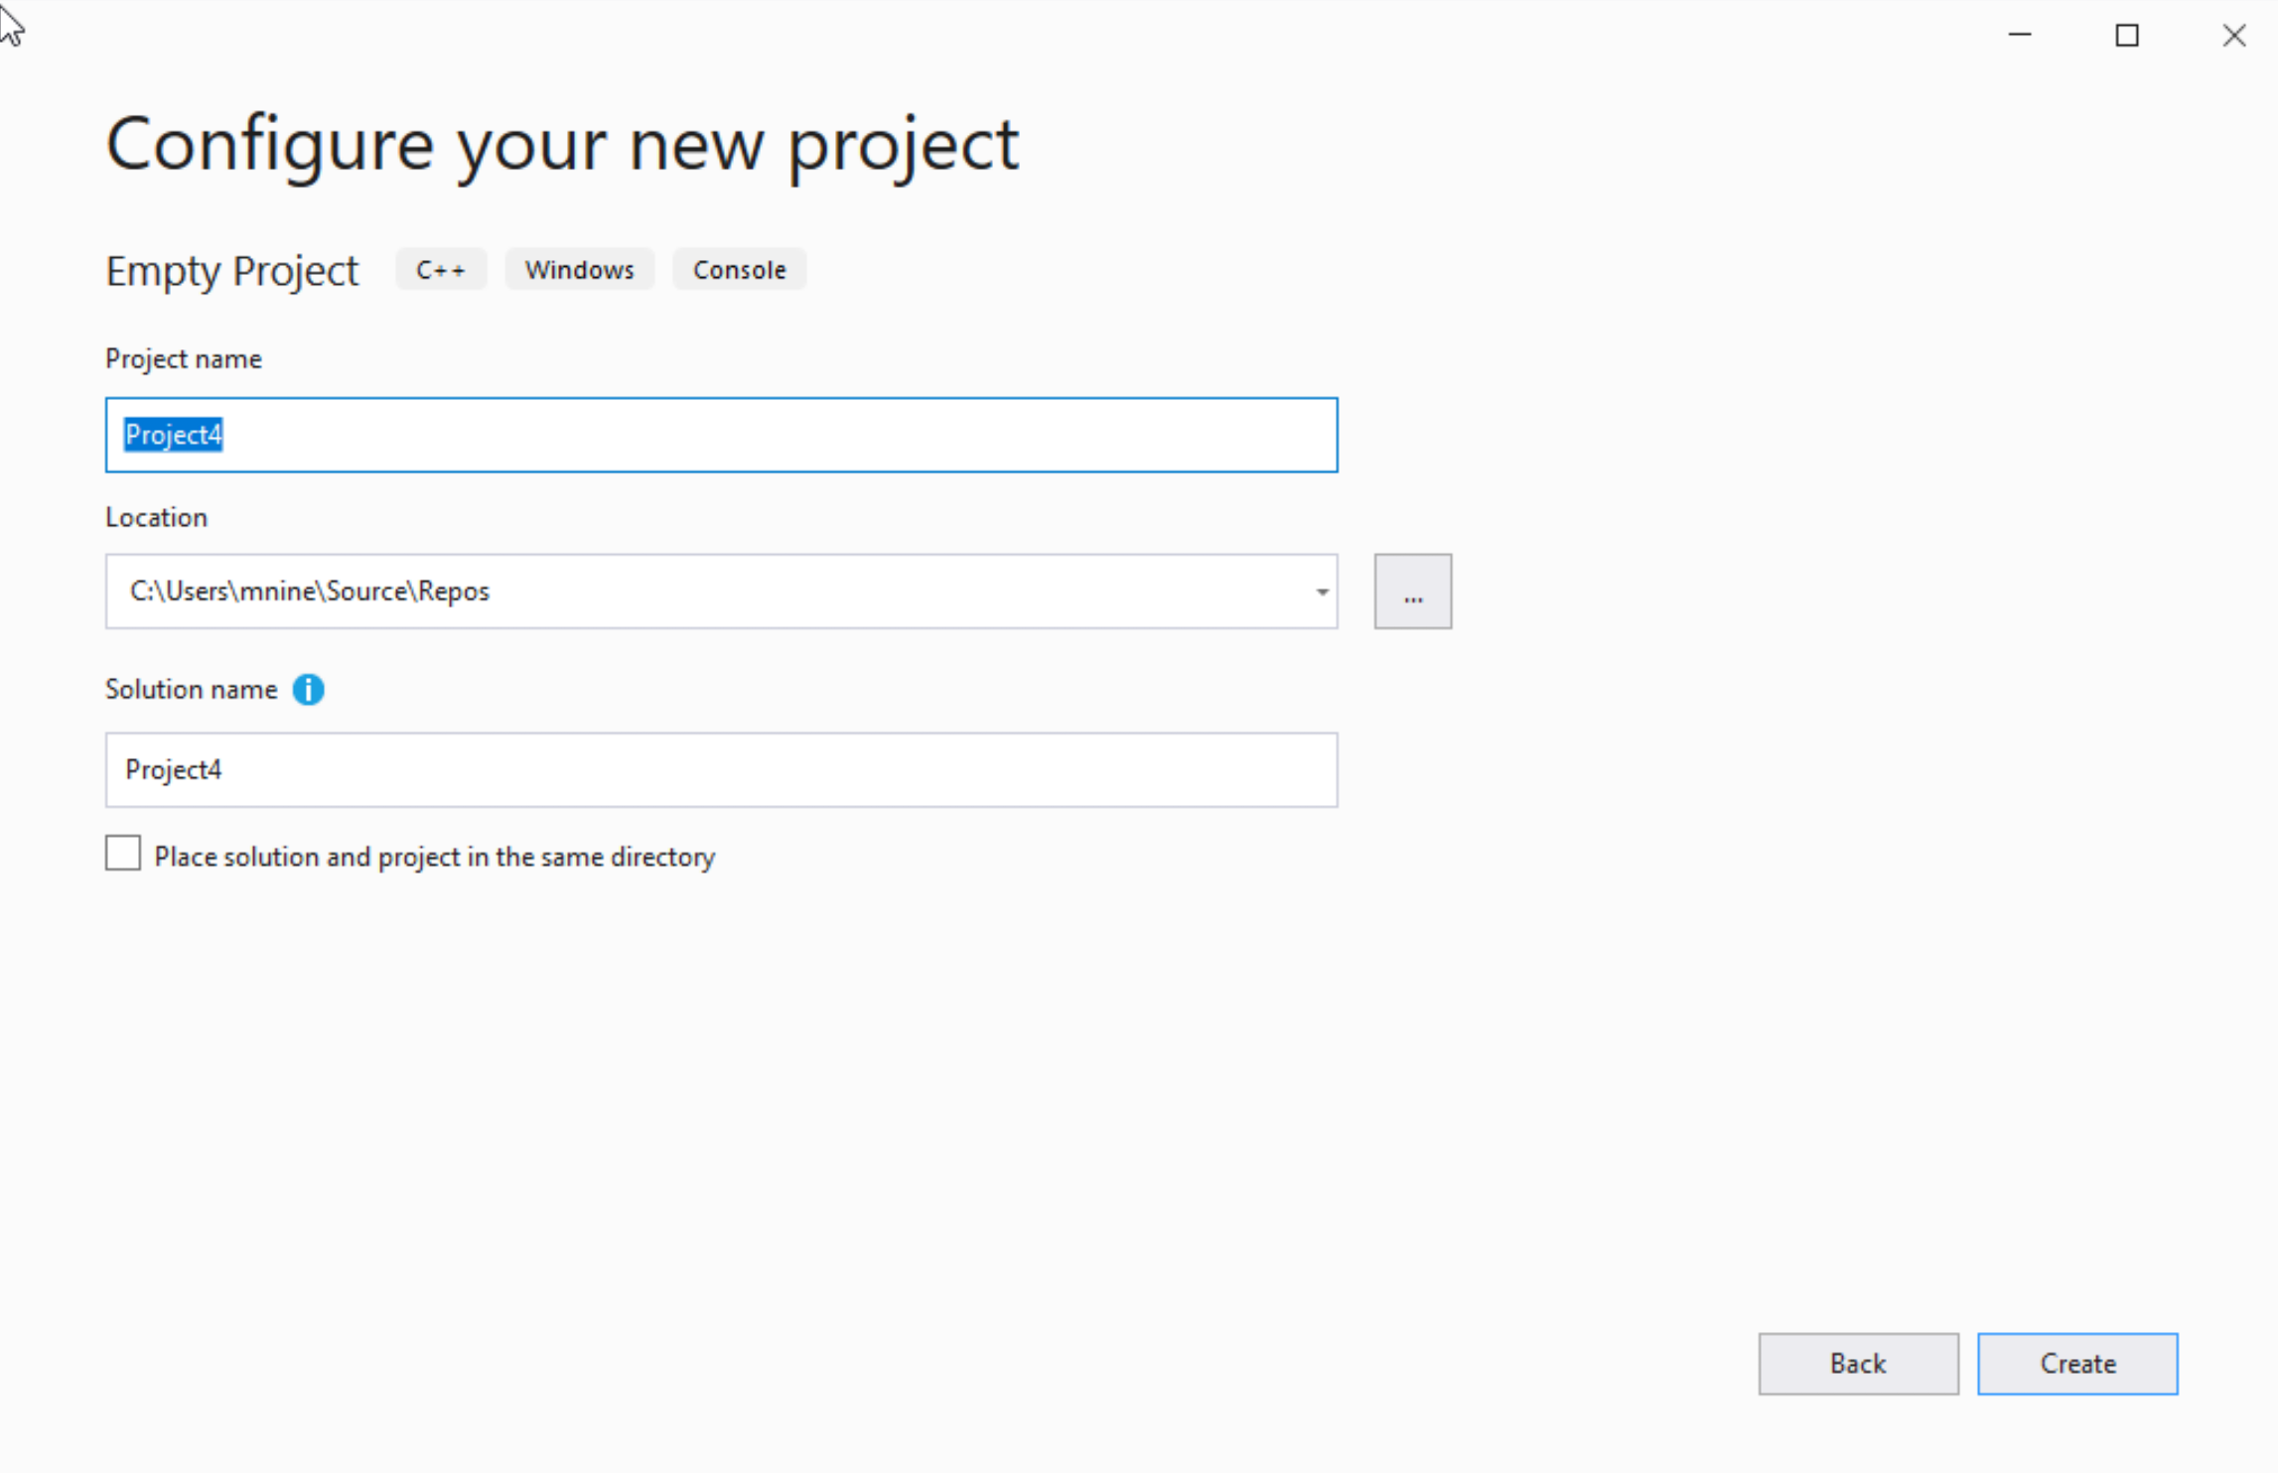

Step 1: Create a project (3)
You can change the project
name as you like
Also, you can change the
project location
Click Next

Slide 15
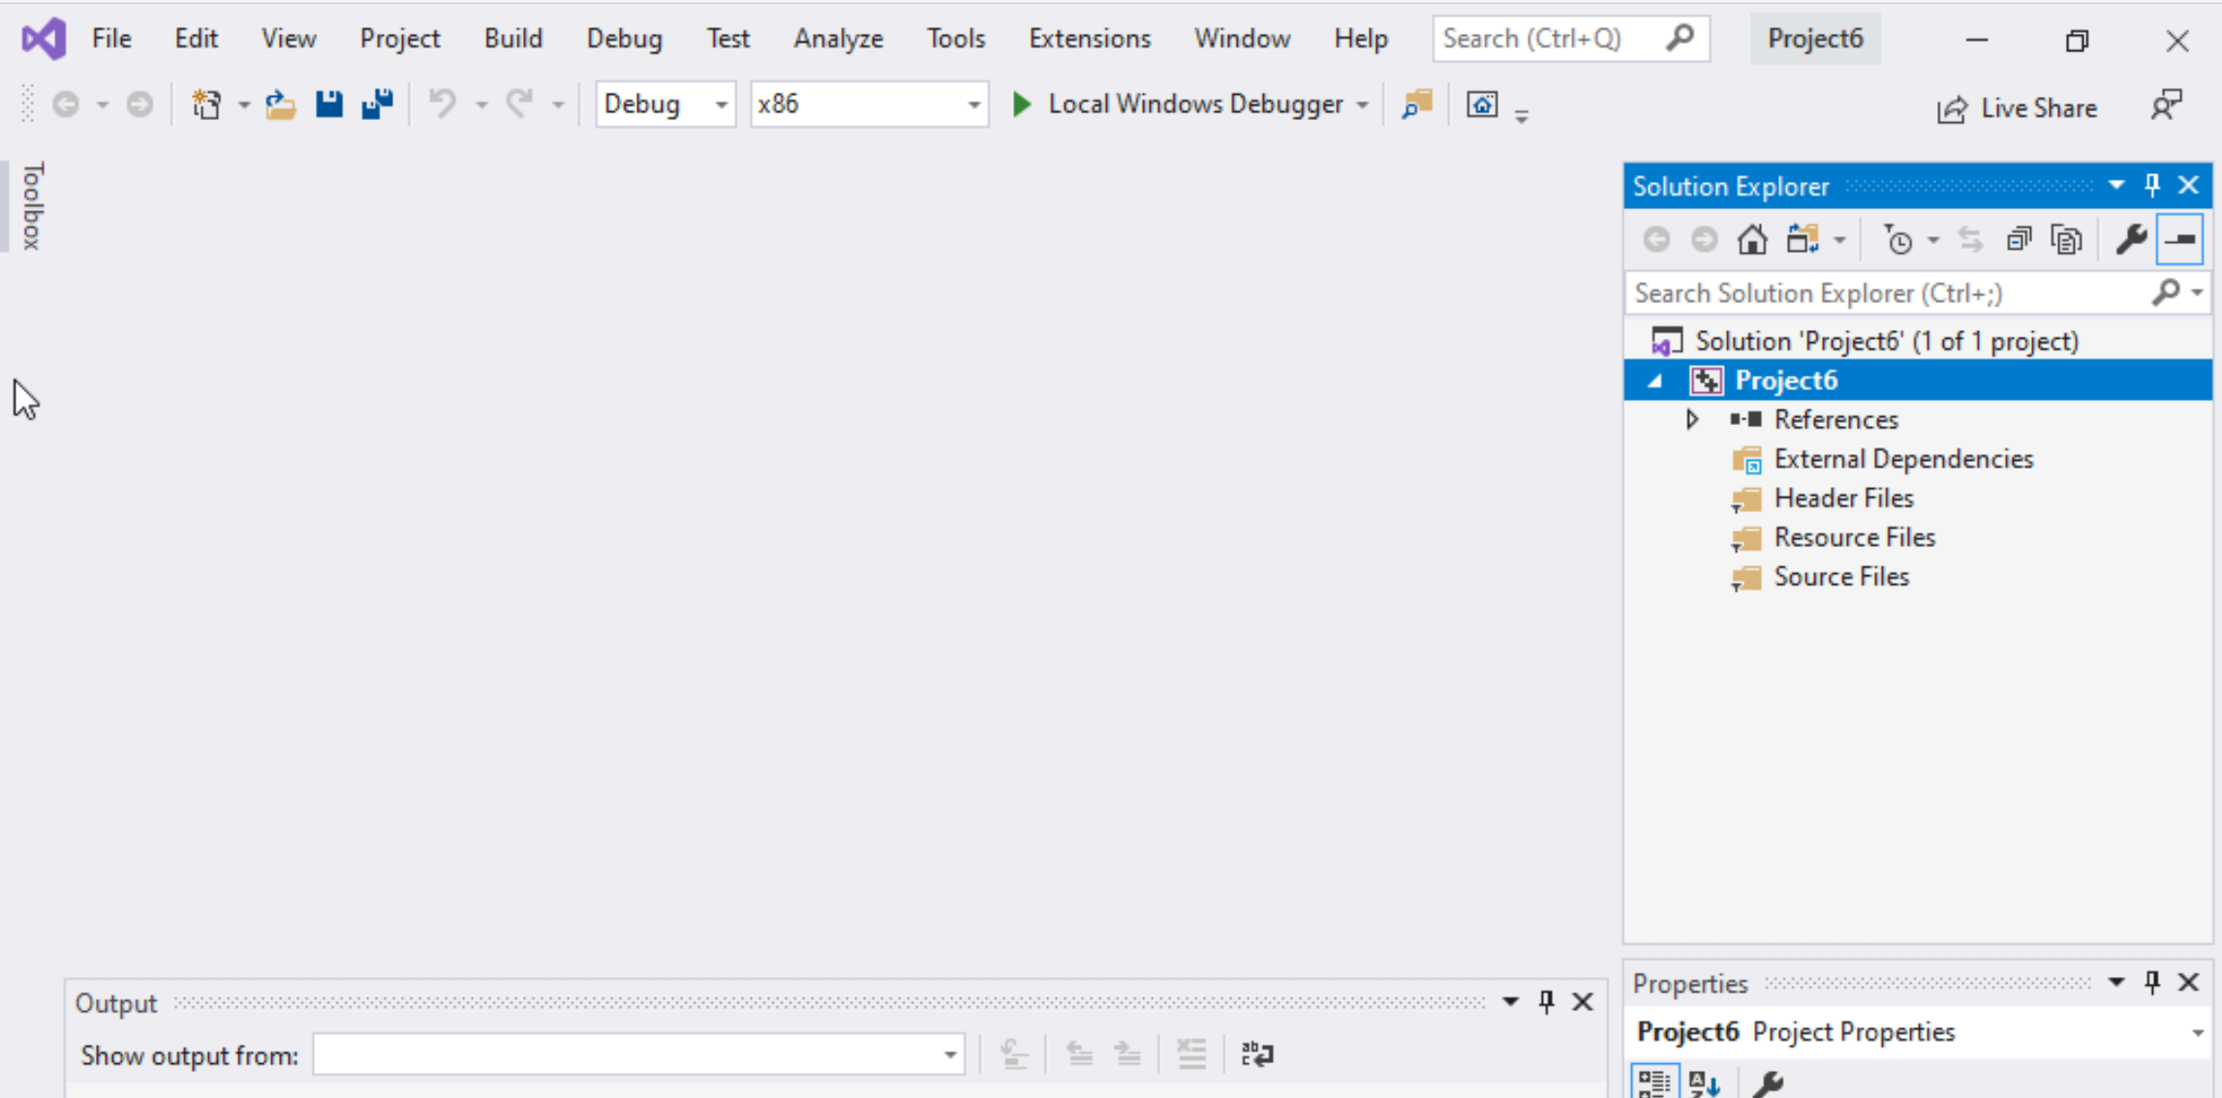
Step 1: Create a project (4)
Delete the
Following folders:
Header files
Resources Files, and
Source Files

Slide 16
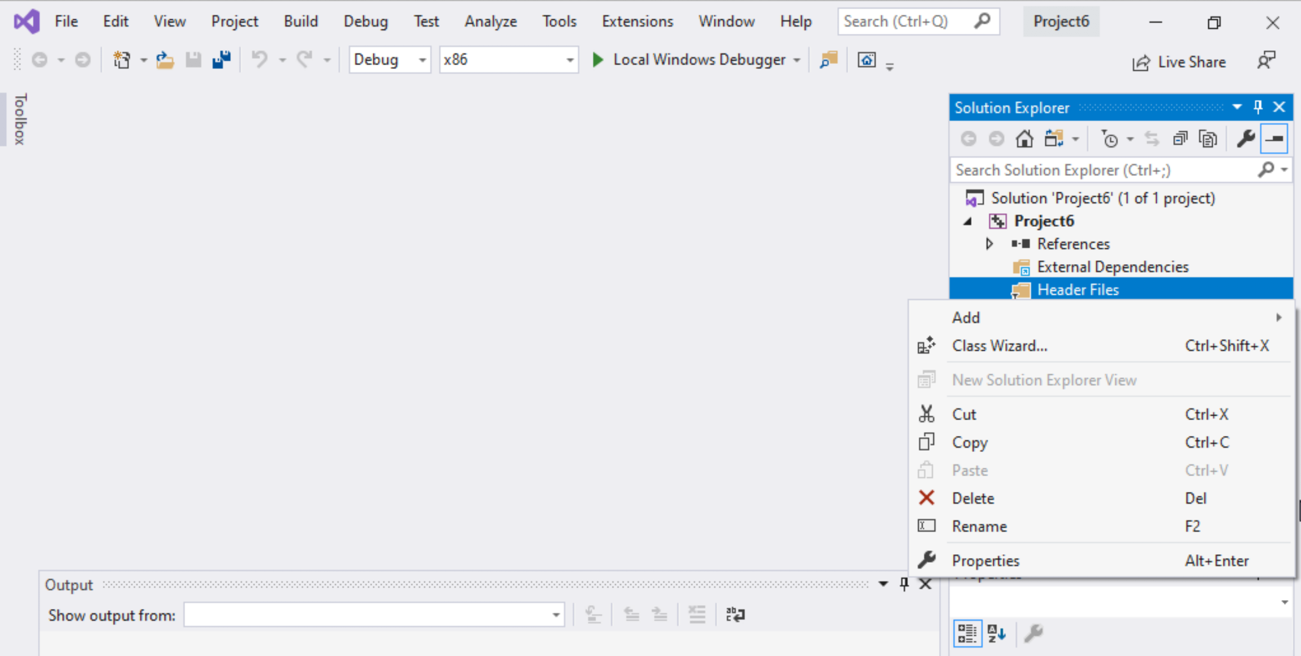
Step 1: Create a project (5)
To delete :
Select the folders
Right click on it
Select delete

Slide 17
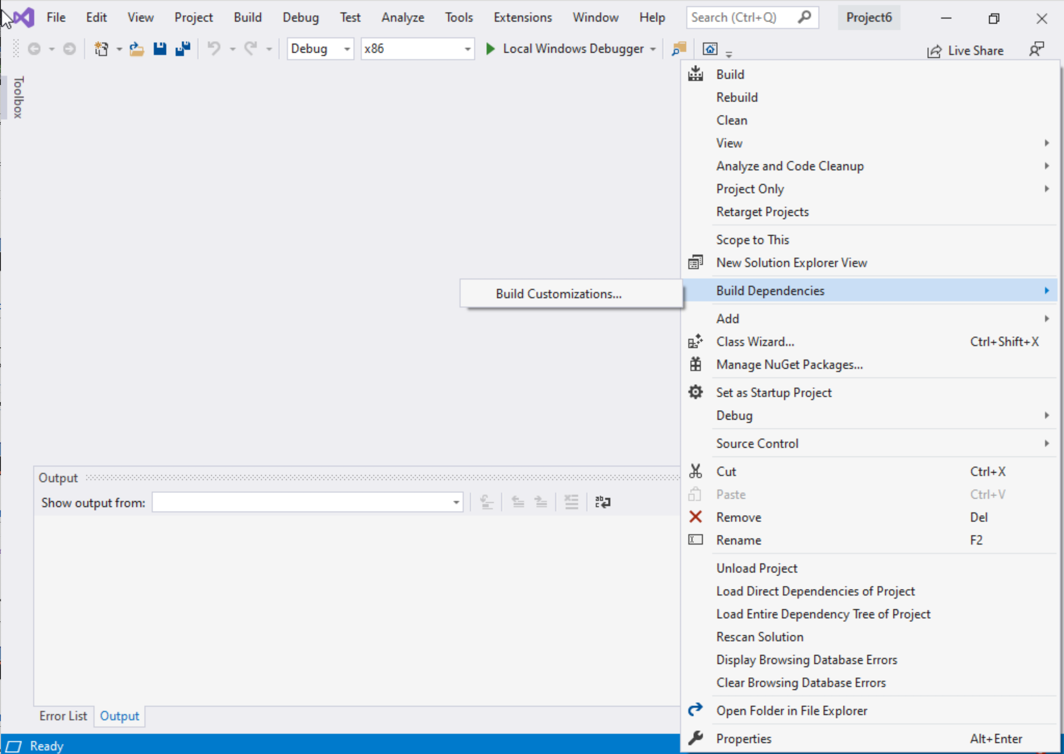
Step 1: Create a project (6)
Select Project Name on solution explorer
Right click on it
Go to Build Dependencies
Click on Build Customizations

Slide 18
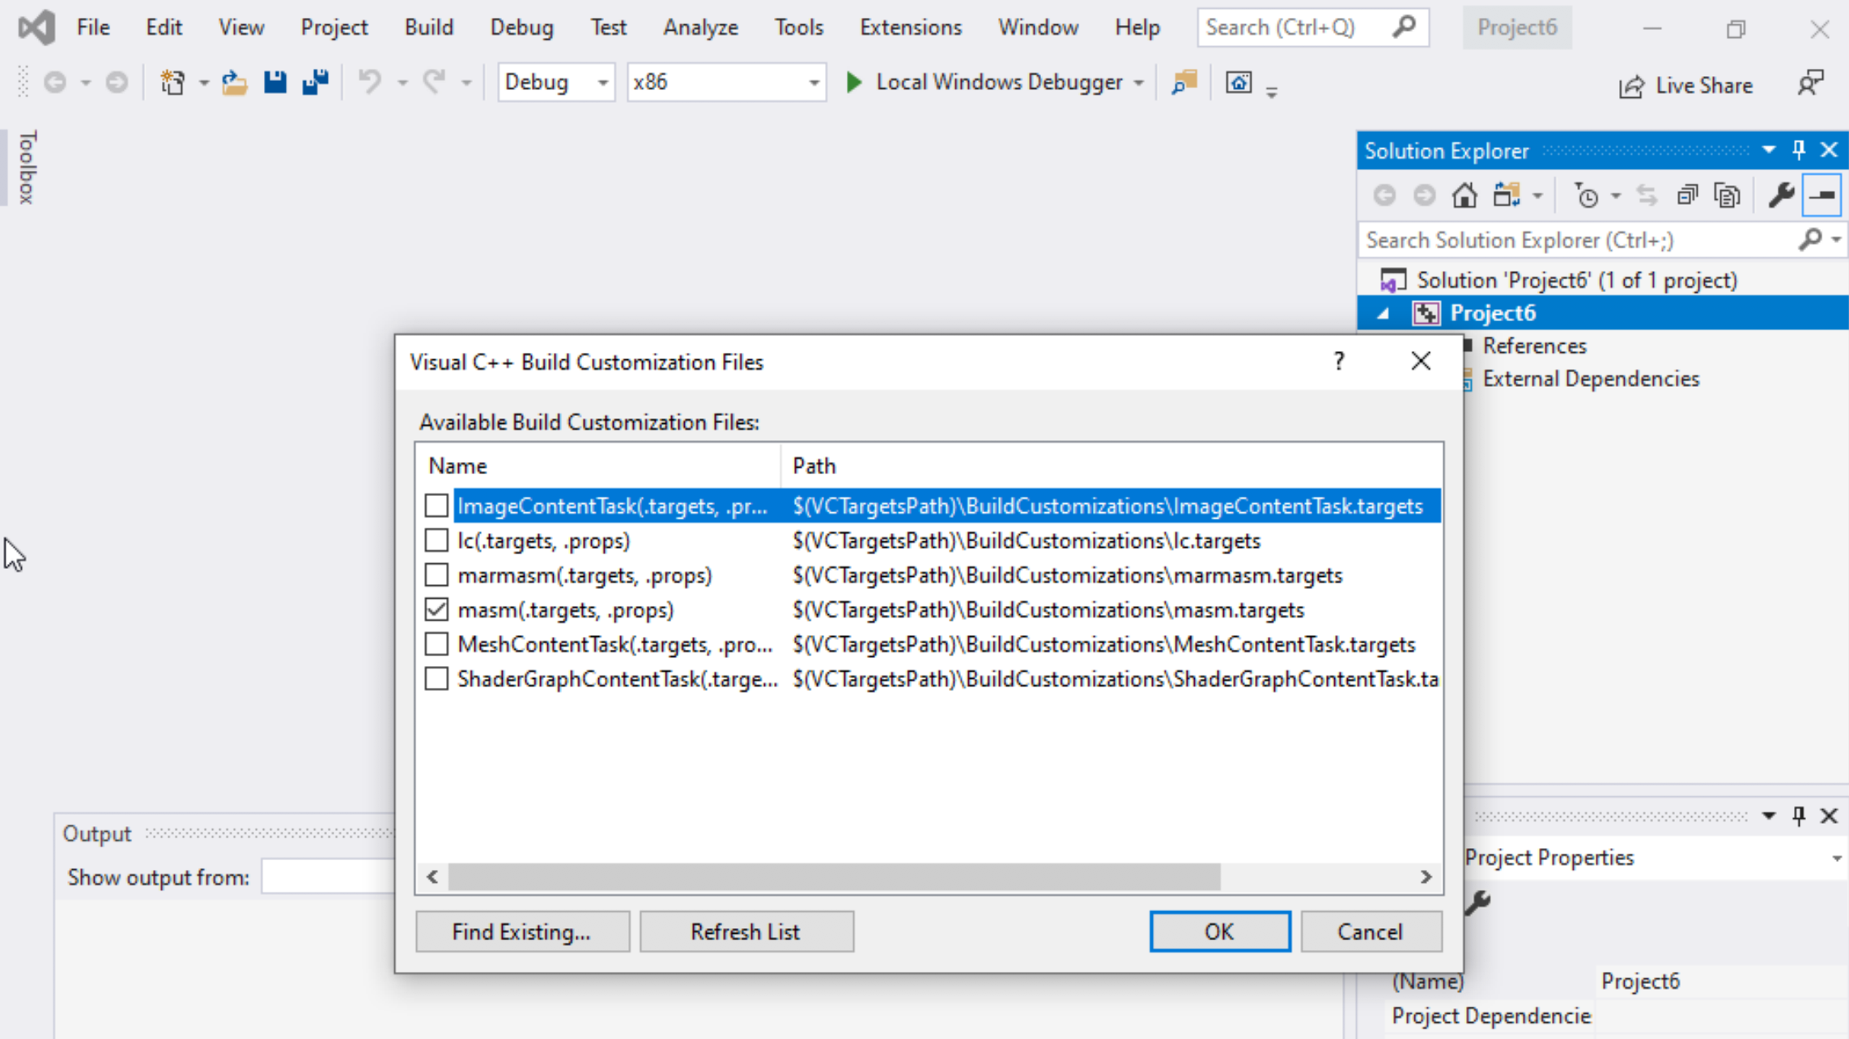
Step 1: Create a project (7)
Select masm(.target, .props)
Click ok

Slide 19
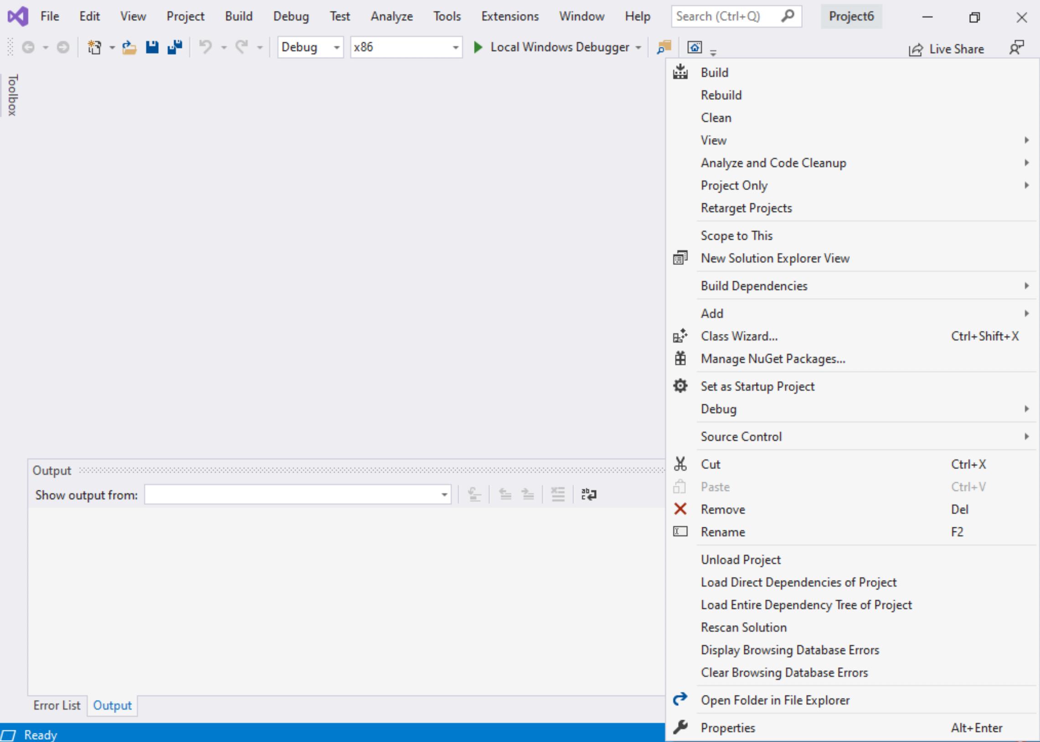
Step 1: Create a project (8)
Right click on the Project name in the solution explorer
Click properties

Slide 20
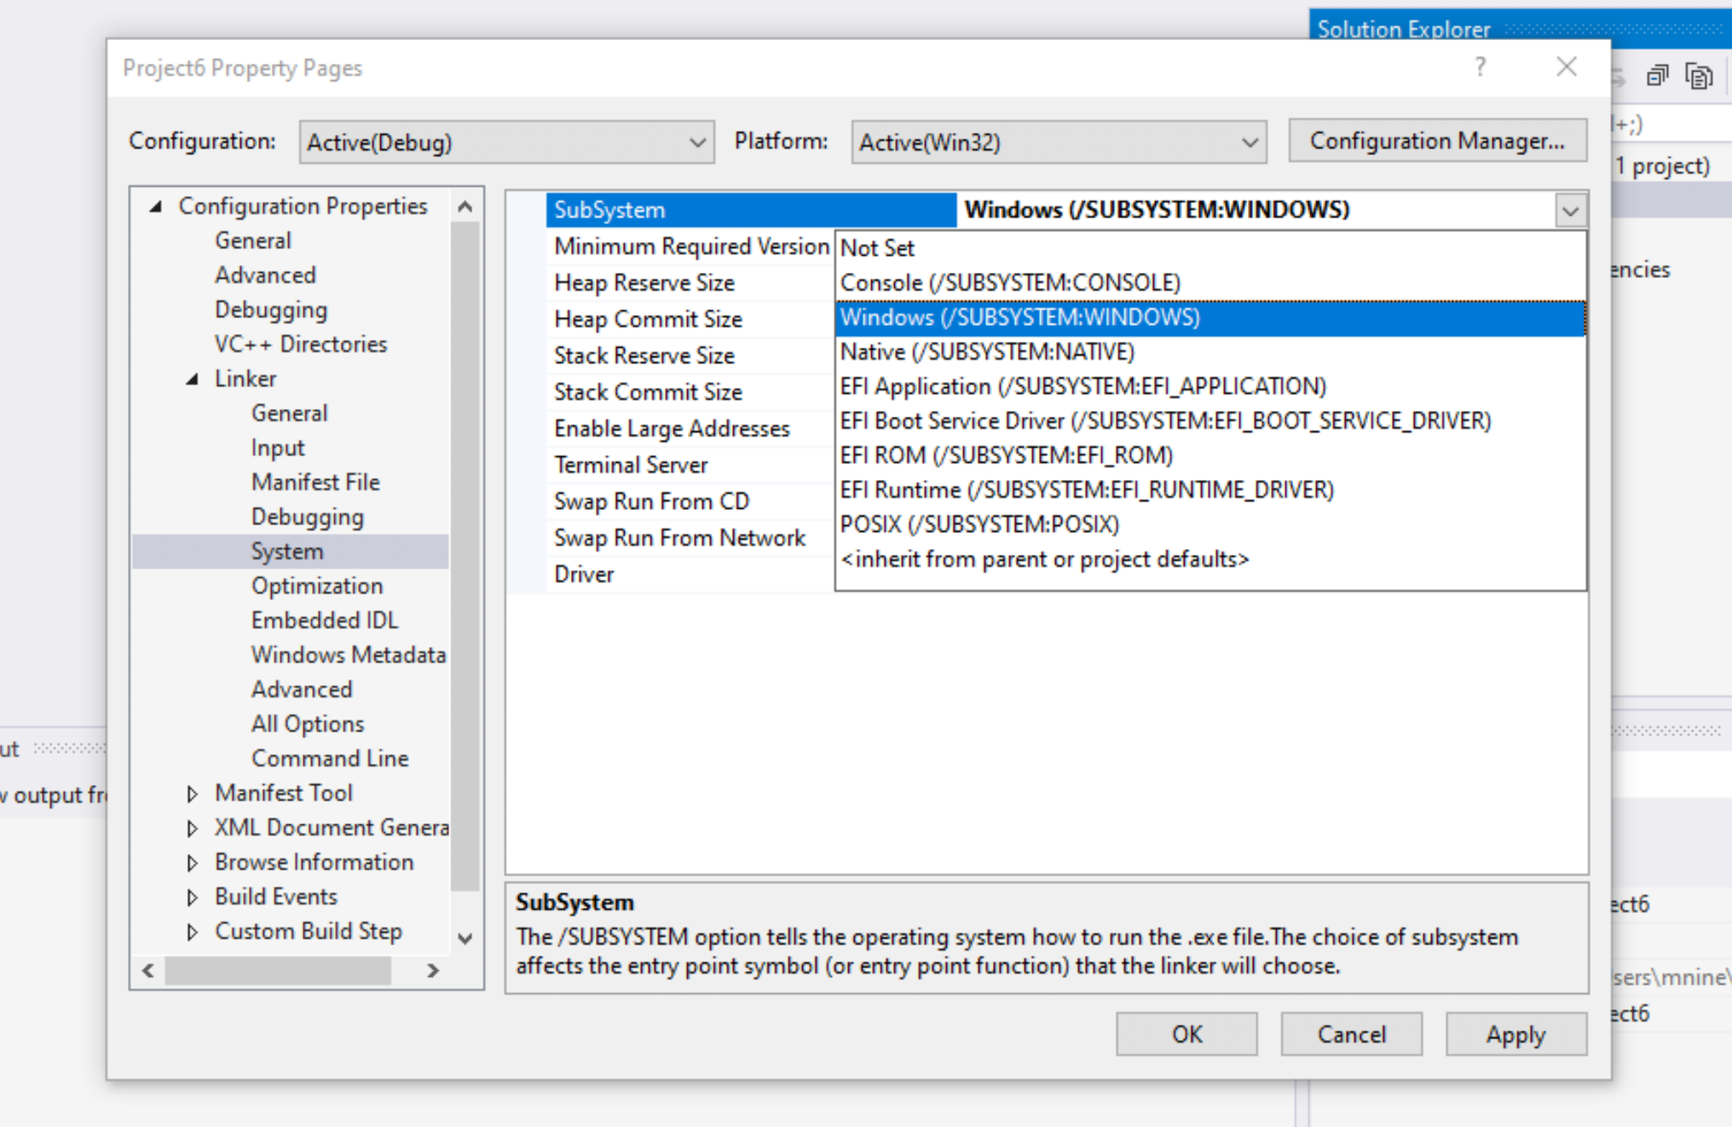

Step 1: Create a project (9)
Expand the ‘Linker’
Select ’System’
Select Windows(/SUBSYSTEM:WINDOWS)
Click OK

Slide 21
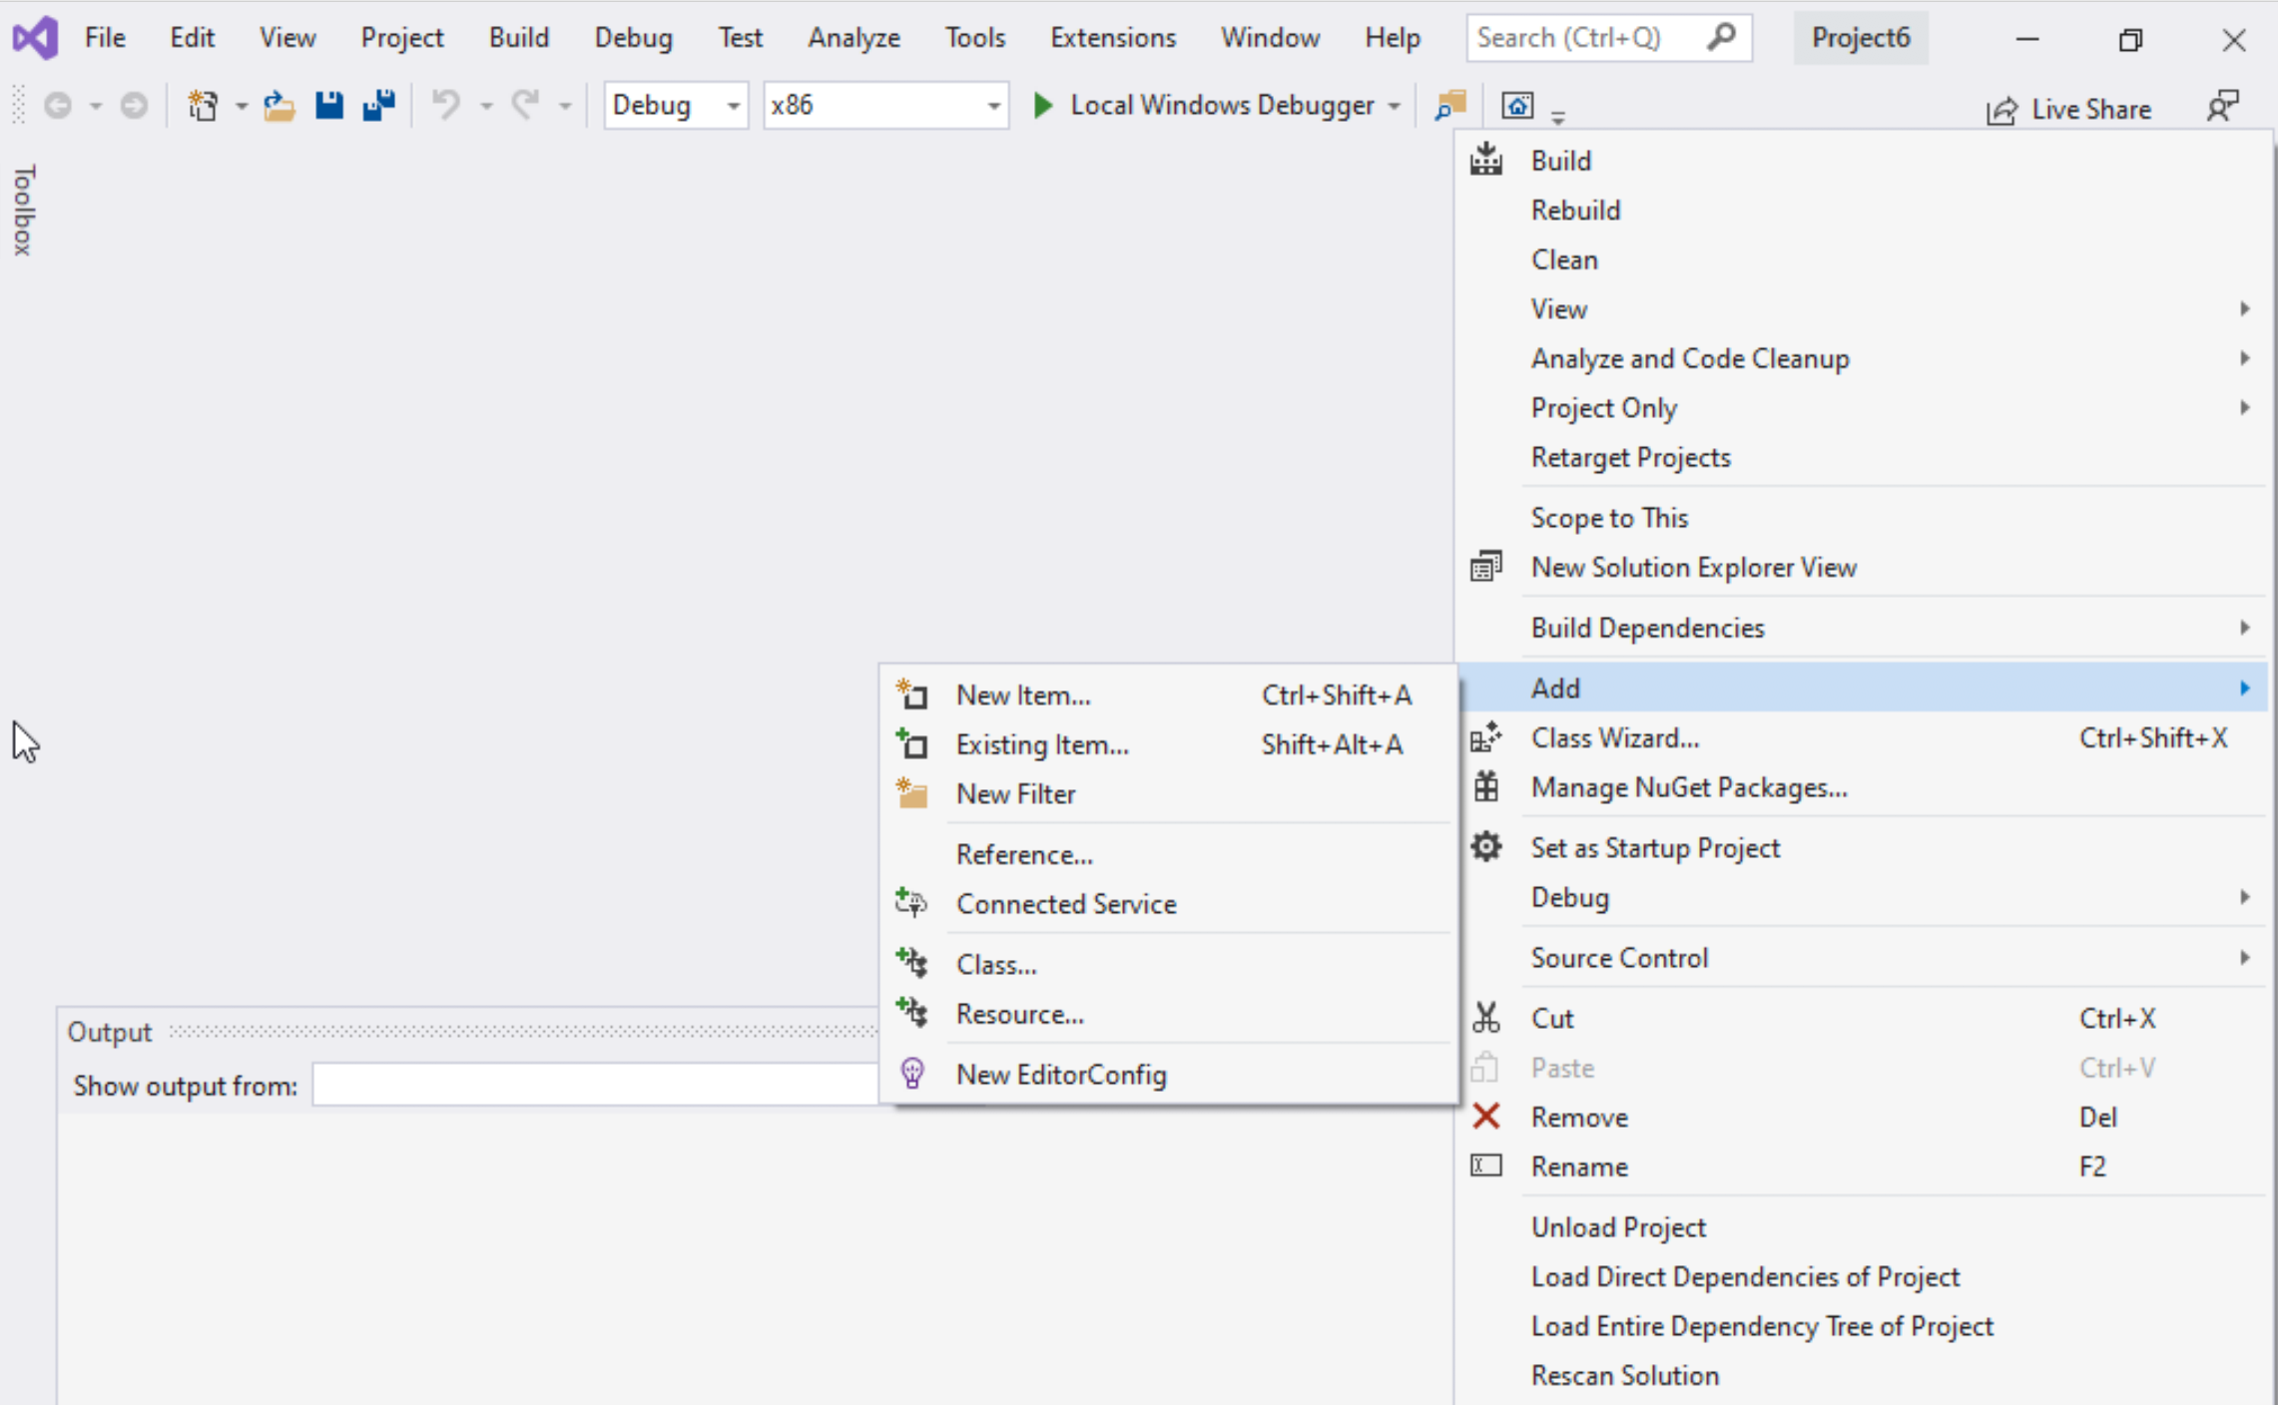
Step 1: Create a project (10)
Select Project name on solution explorer
Right click on it
Expand Add
Choose New Item

Slide 22
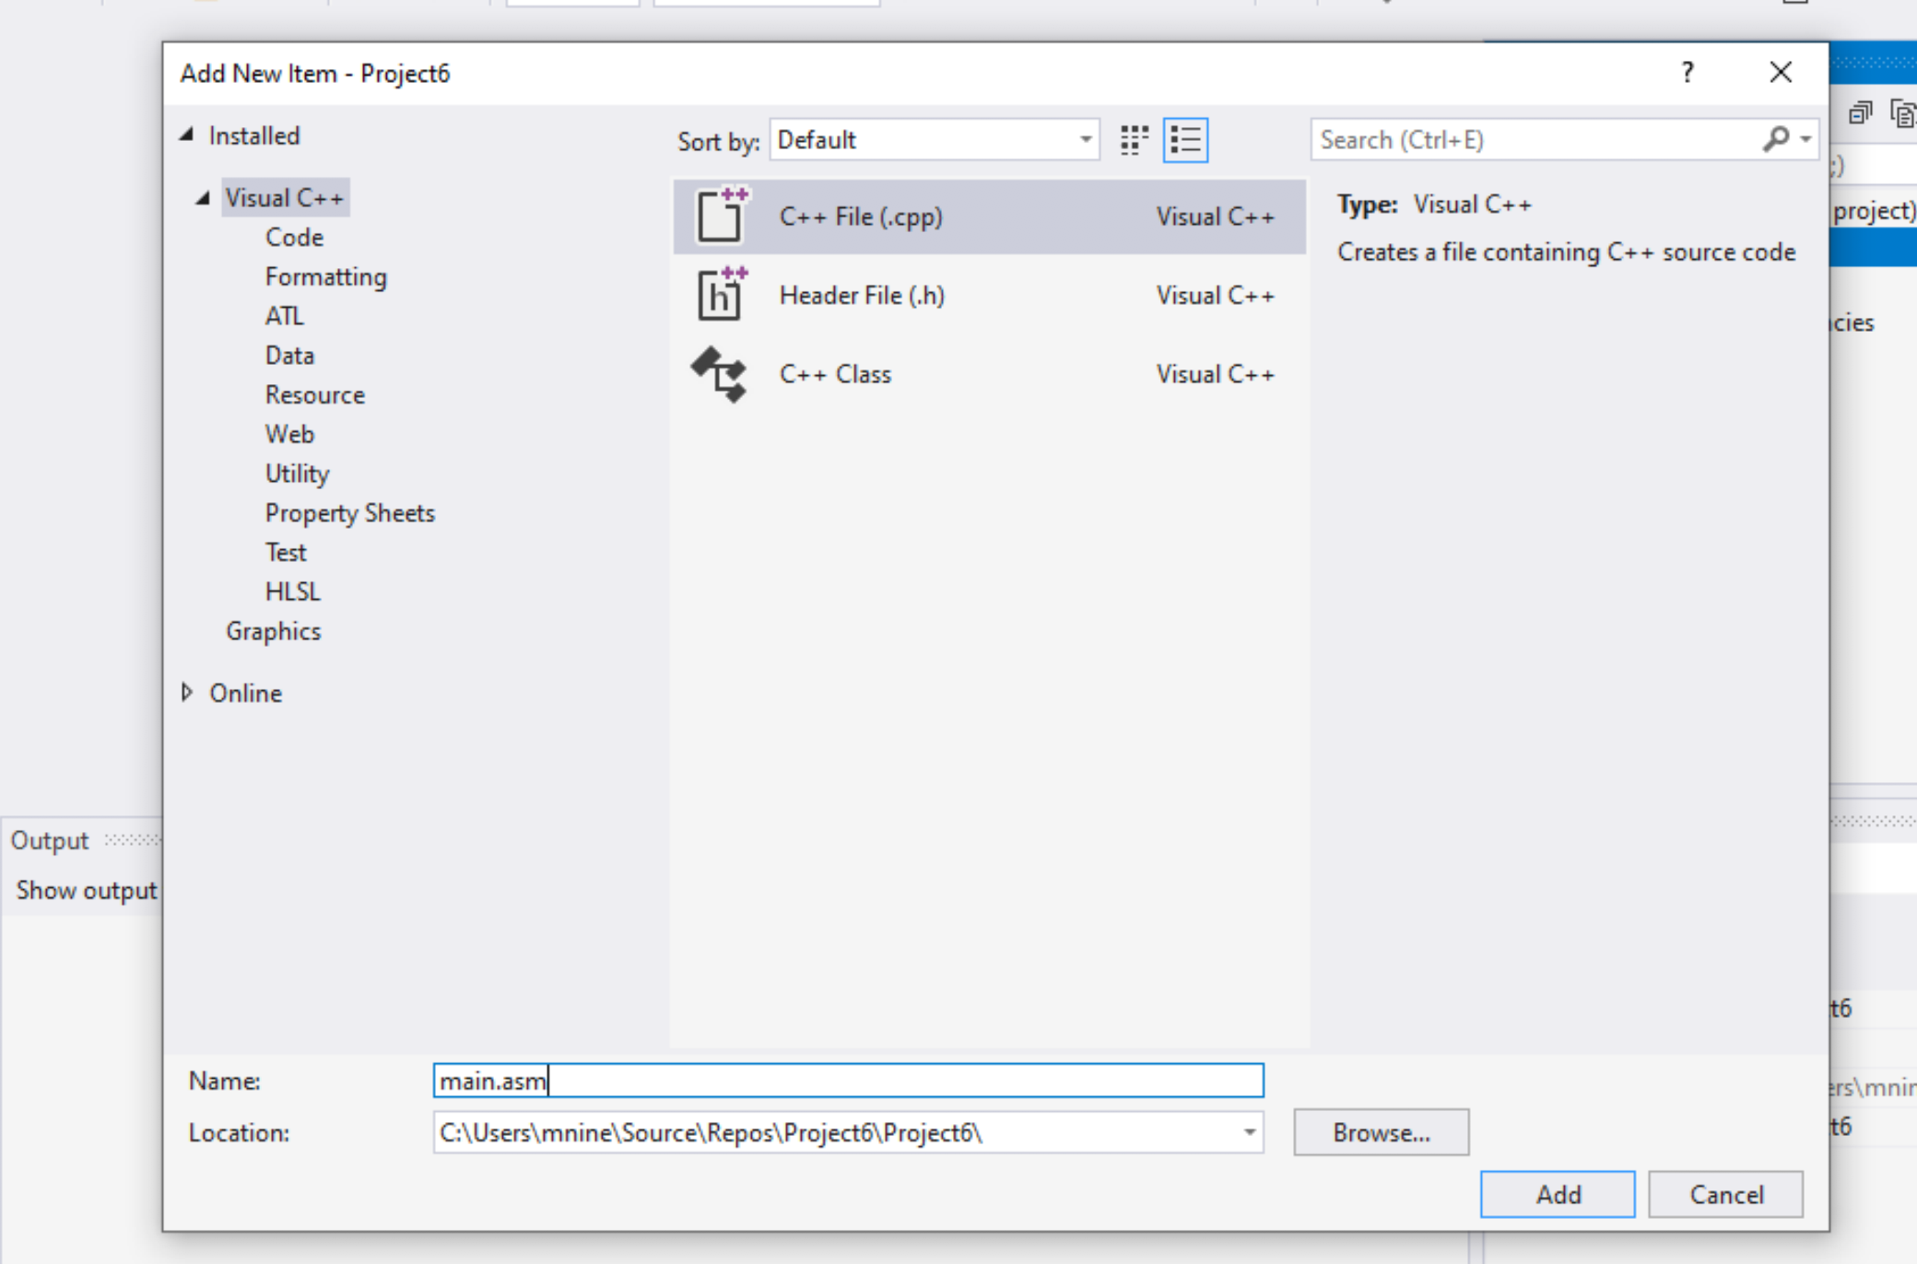


Step 1: Create a project (11)
Select C++ File(.cpp)
Name: main.asm
Click Add

Slide 23
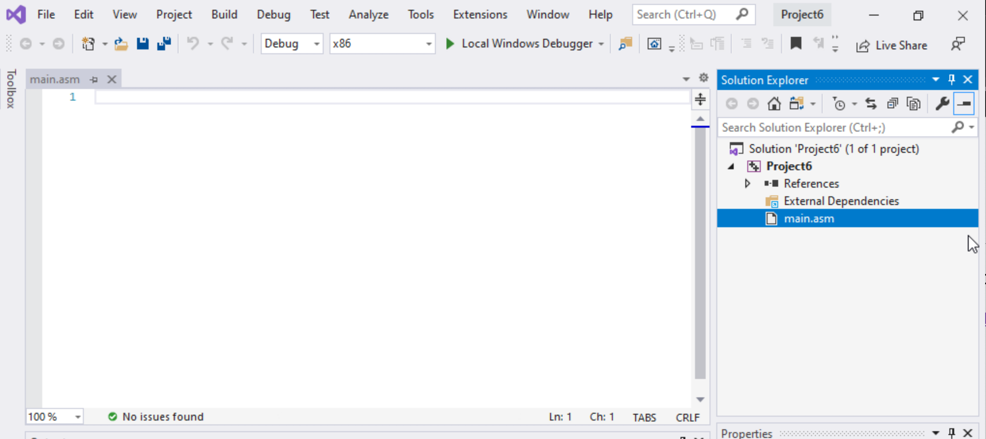

Step 1: Create a project (12)
Select main.asm
Add your code
In the main.asm File.

